Slide 1
imageTracer
Phil Gee
CS701 - Fall 1 - 2022
Term Project

Slide 2
Welcome to imageTracer
Welcome to the imageTracer VueJS Single Page Application!
You can search for an image by typing into the search bar. Results will load automatically. Once you find something you like, select it and enter an interface where an HTML Canvas element is layered over top of the image you selected. You will be able to use a draggable “painter’s palette” for various controls as you are tracing/drawing over the image. You can save your work to your Library to refer to and continue working on later. You also have the option to export your tracing as a PNG.

Slide 3
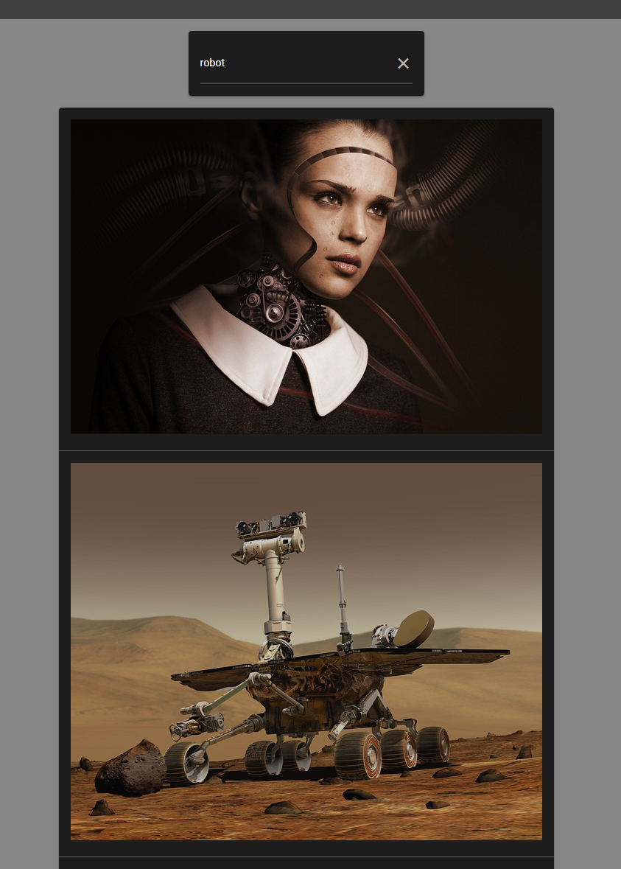
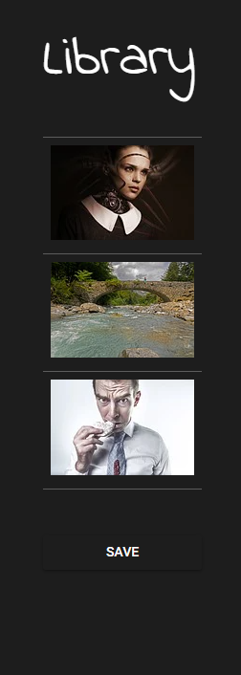
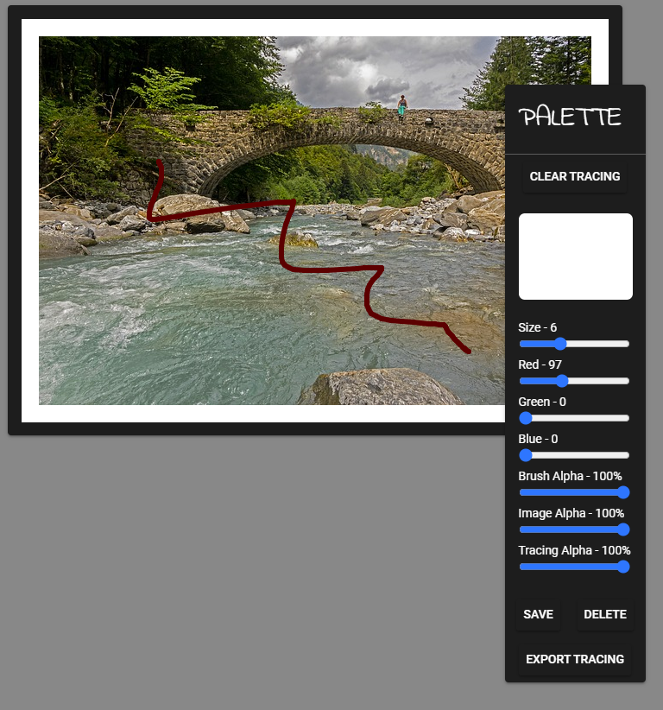
The 3 Main Sections:
1. Search
2. Library
3. Tracing Canvas

Slide 4
Technologies
HTML/CSS
SCSS
VueJS 3 in TypeScript
Composition API with <script setup>
Pinia (state management) in TypeScript
Quasar (interface framework for styling/layout)
Quasar CLI
Fetch API (Pixabay.com photo library; JSON)
HTML5 Canvas
Local Storage (‘term_project_Gee’)
File System (PNG file download)

Slide 5
Demo
http://localhost:9000

Slide 6
Questions?

